Slide 1


XML(EXTENSIBLE MARKUP LANGUAGE)
&
JSON(JavaScript Object Notation)
by 108316135林廣濤

Slide 2
XML (eXtensible Markup Language)

Slide 3

XML(EXTENSIBLE MARKUP LANGUAGE)
特點:
很像HTML，皆屬標籤語言

Slide 4
XML
(EXTENSIBLE MARKUP LANGUAGE)
特點:
只供儲存、傳輸

Slide 5
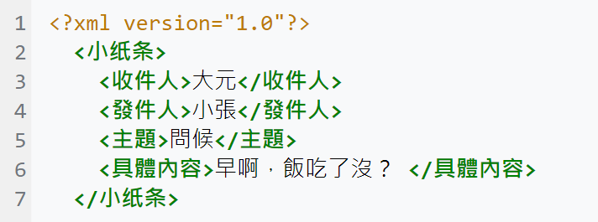
XML (EXTENSIBLE MARKUP LANGUAGE)

Slide 6
XML (EXTENSIBLE MARKUP LANGUAGE)
It simplifies data sharing
It simplifies data transport
It simplifies platform changes
It simplifies data availability

Slide 7
JSON (JavaScript Object Notation)

Slide 8
JSON (JAVASCRIPT OBJECT NOTATION)
{ "InsuranceCompanies": { "Top_Insurance_Companies": { "Name": "Berkshire Hathaway ( BRK.A)", "Market_Capitalization": "$539 billion" } } }

Slide 9
JSON (JAVASCRIPT OBJECT NOTATION)
不用 end tag
資料跟XML相比會必較短
易讀性較高
可以使用陣列

Slide 10

Thanks!
Any questions?
You can find me at:
108316135@gms.tcu.edu.tw
108316101@gms.tcu.edu.tw

